Slide 1


The Story of AtliQ Hardware: Harnessing Data to Drive Growth
AtliQ Hardware, a rapidly growing electronics company, sought to transform its business operations by leveraging data to make informed decisions. By adopting a data-driven approach, AtliQ aimed to overcome challenges and achieve sustainable growth.

Slide 2
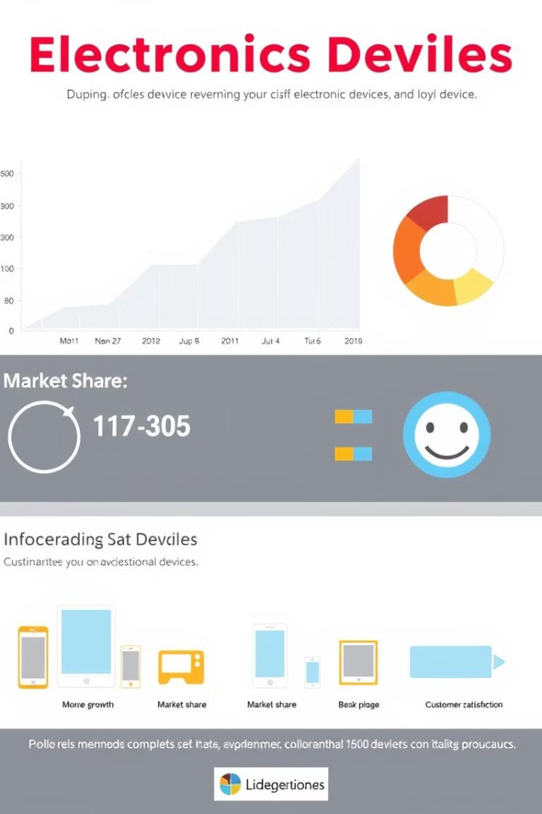


About AtliQ Hardware: A Fast-Growing Electronics Company
AtliQ Hardware is a leading electronics company serving prominent clients like Croma and Amazon, specializing in a diverse range of electronic devices.
1
Market Presence
2
Product Portfolio
AtliQ has a strong presence in the electronics market, serving a wide customer base.
The company boasts a comprehensive product portfolio, encompassing various electronic devices to cater to diverse needs.
3
Growth Strategy
AtliQ has a clear growth strategy, focusing on expanding its market share and product offerings.

Slide 3
Challenges in Latin America: Intuition-Based Decisions Leading to Losses
Despite its success, AtliQ faced significant challenges in its Latin American operations. Reliance on intuition-based decision-making led to losses in this key market.
Intuition-Based Decisions
Lack of Data Analysis
Competitive Landscape
Decisions were often made based on intuition and gut feeling, leading to inaccurate forecasts and inefficiencies.
AtliQ lacked a systematic data analysis process, hindering its ability to identify trends and understand customer behavior.
The Latin American market was highly competitive, with established players leveraging data to gain a competitive edge.

Slide 4

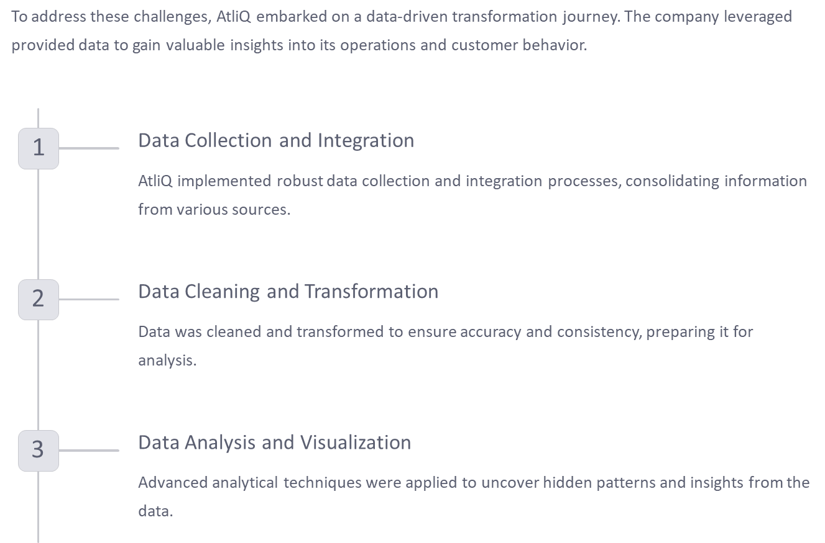
Introducing the Data-Driven Approach: Leveraging Provided Data

Slide 5
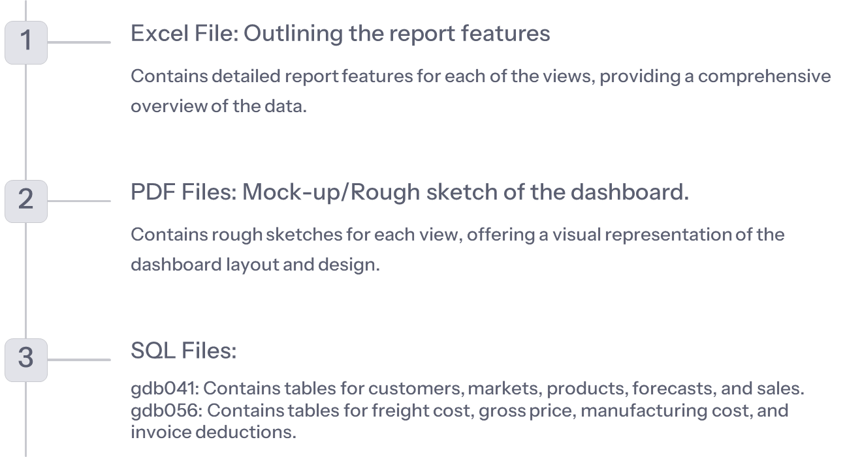
Understanding the Data Landscape

Slide 6
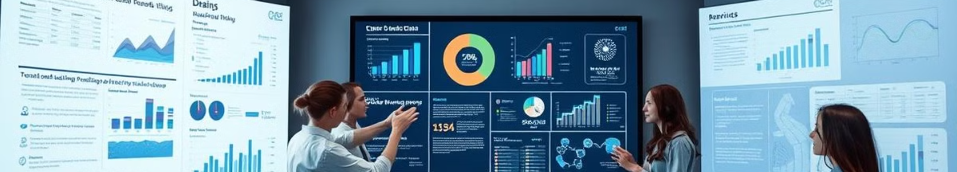
Key Stakeholder Views: Finance, Sales, Marketing, Supply Chain, and Executive
AtliQ recognized the importance of aligning stakeholder perspectives. The company developed tailored dashboards for key stakeholders, providing insights relevant to their respective areas.
Finance
Sales
Marketing
Supply Chain
Executive
Financial performance
Sales performance
Marketing campaign effectiveness
Inventory management and logistics
Overall business performance

Slide 7
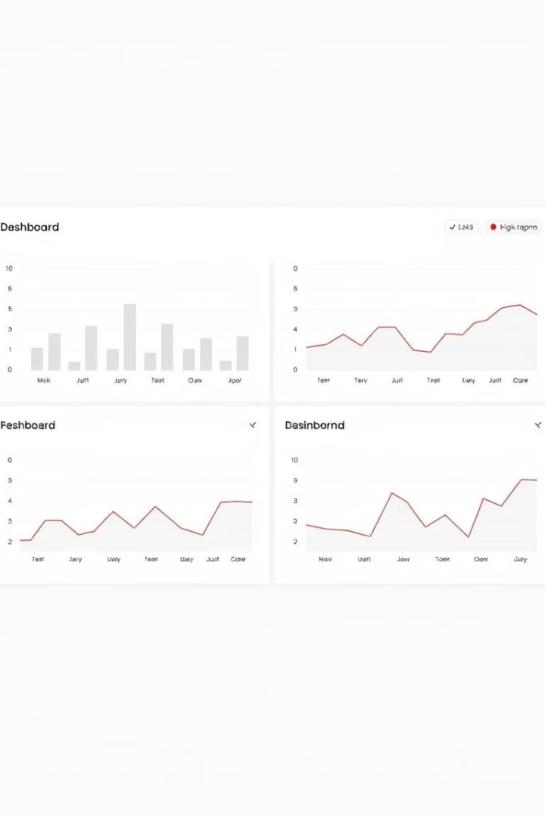



Designing the Dashboard: Translating Data into Actionable Insights
The dashboards were designed to present data in an intuitive and actionable way, enabling stakeholders to make informed decisions.
Data Exploration
Users could explore data through interactive filters and drill-down capabilities, gaining granular insights.
Key Performance Indicators (KPIs)
Key performance indicators (KPIs) provided a concise view of critical business metrics.
Trend Analysis
Dashboards facilitated trend analysis, helping stakeholders identify patterns and forecast future performance.

Slide 8
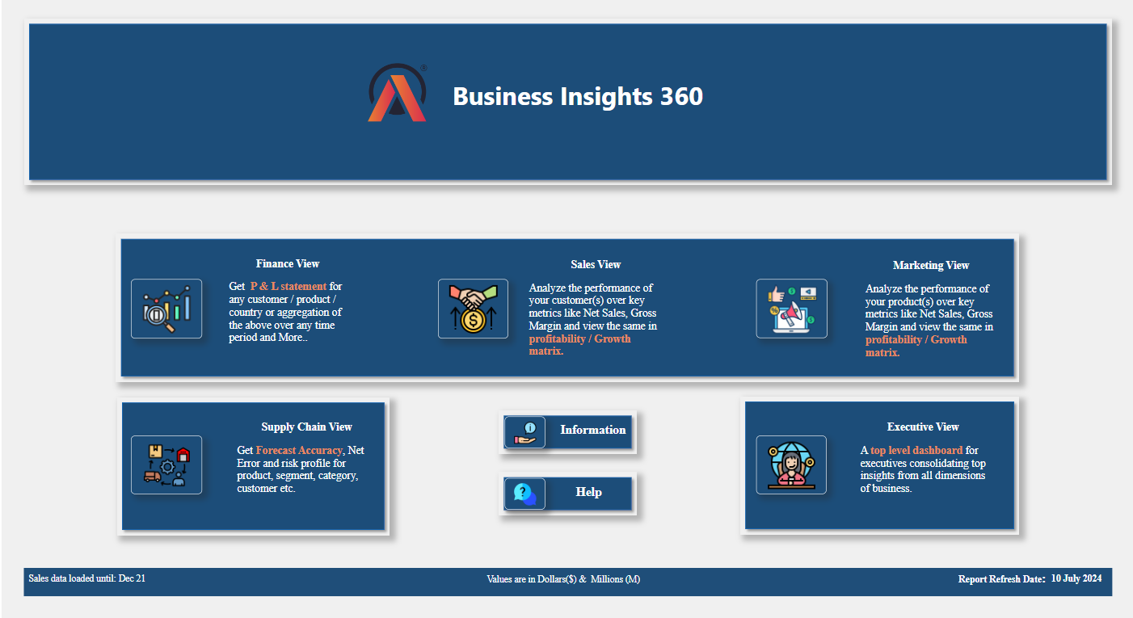
Home View:
The Home view provides a central navigation facility with buttons to access any view within the dashboard. It serves as the main entry point, allowing users to quickly navigate to different sections such as Finance, Sales, Marketing, Supply Chain, and Executive views.

Slide 9
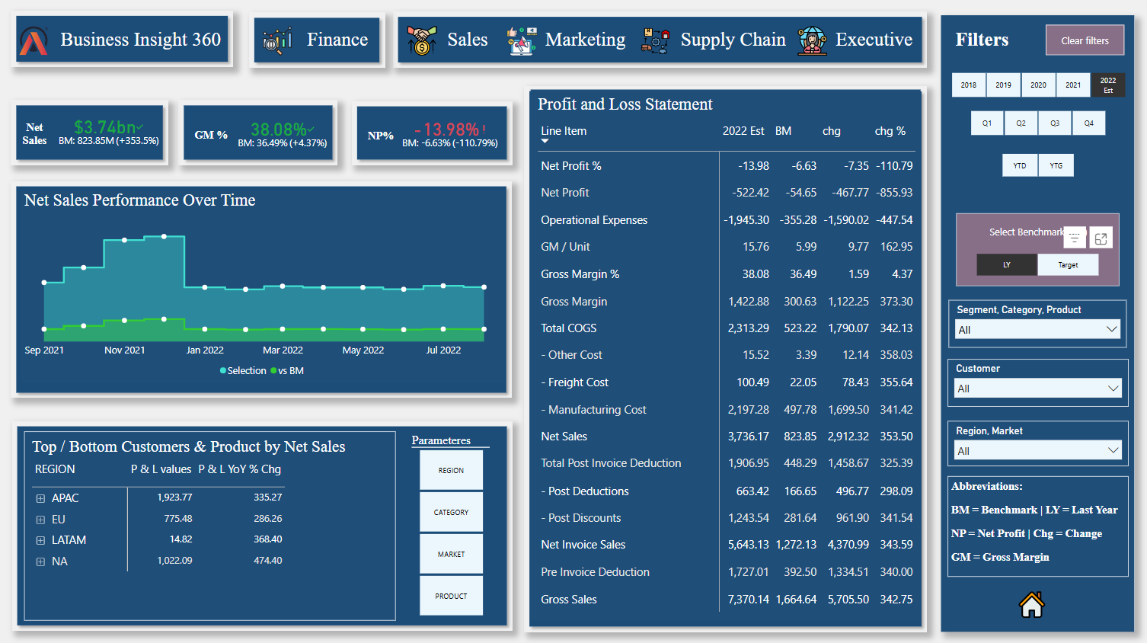
Finance View:
The Finance view offers a comprehensive analysis of the company's financial performance. It includes:
Profit and Loss Statements Matrix: Detailed breakdown of revenue, expenses, and profit.
Net Sales Performance Over Time: Visual representation of net sales over time in compared with last year and target.
Top / Bottom Customers & Product by Net Sales: Identification of the best and worst-performing customers and products based on net sales.
Net Sales, Gross Margin %, Net Profit % KPIs: Compared with Last Year as well the targets.
Lack of Data Analysis
Competitive Landscape
AtliQ lacked a systematic data analysis process, hindering its ability to identify trends and understand customer behavior.
The Latin American market was highly competitive, with established players leveraging data to gain a competitive edge.

Slide 10
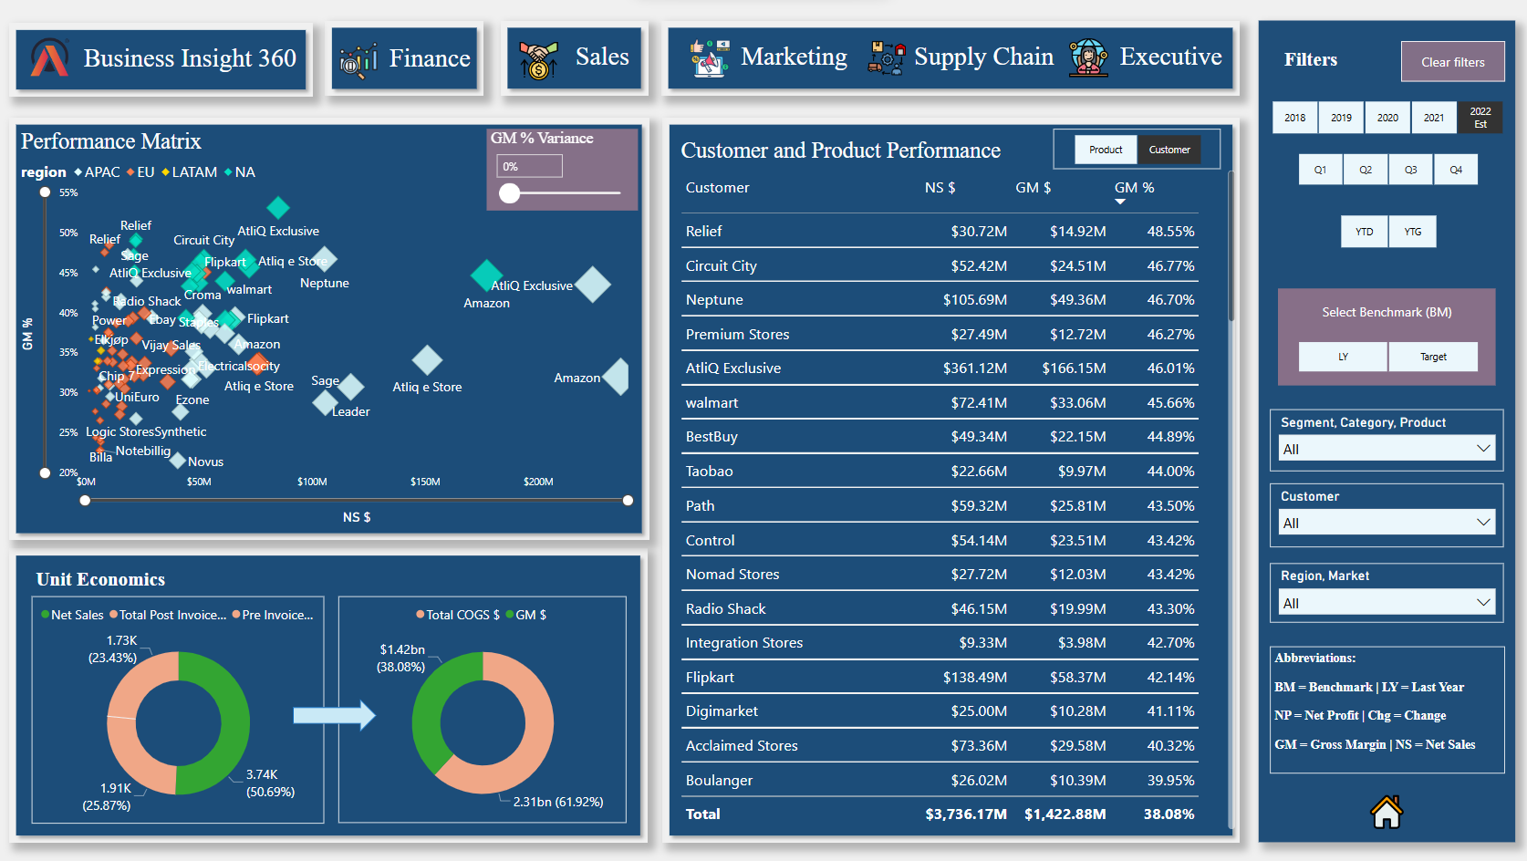
Sales View:
The Sales view focuses on customer and product performance, providing insights into:
Customer and Product Performance Matrix: Analysis of Net Sales, GM, GM% performance for different customers and product.
Performance Matrix: Visual representation of Gross Margin % and Net Sales for customers.
Unit Economics: Breakdown of total Cost of Goods Sold (COGS) and deductions.
Lack of Data Analysis
Competitive Landscape
AtliQ lacked a systematic data analysis process, hindering its ability to identify trends and understand customer behavior.
The Latin American market was highly competitive, with established players leveraging data to gain a competitive edge.

Slide 11
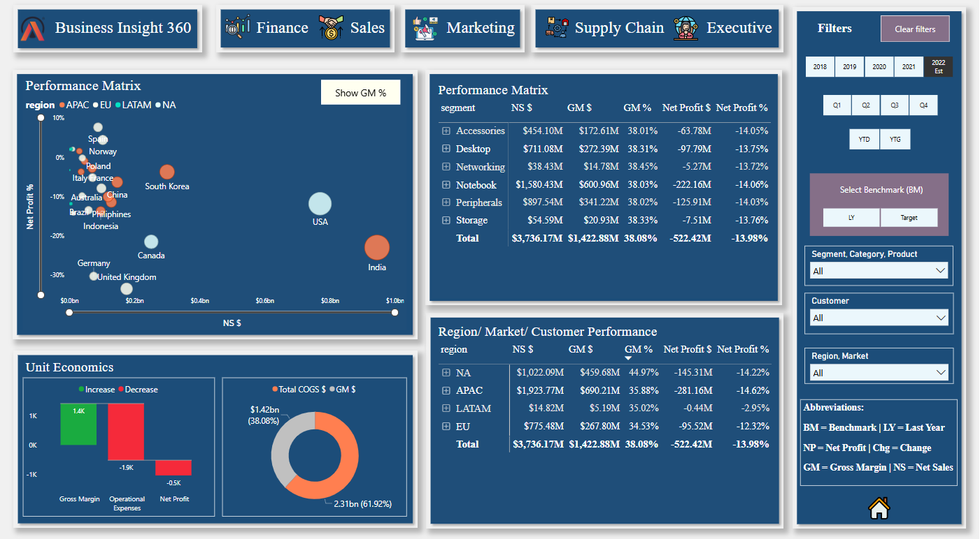
Marketing View:
The Marketing view evaluates the performance of different regions, markets, and customers, including:
Region / Market / Customer Performance: Analysis of performance based on net profit and net profit %.
Performance Matrix: Evaluation of product performance based on net sales, gross margin, gross margin %, net profit and net profit % .
Unit Economics: Breakdown of total Cost of Goods Sold (COGS), gross margin, operational expenses and net profit.

Slide 12
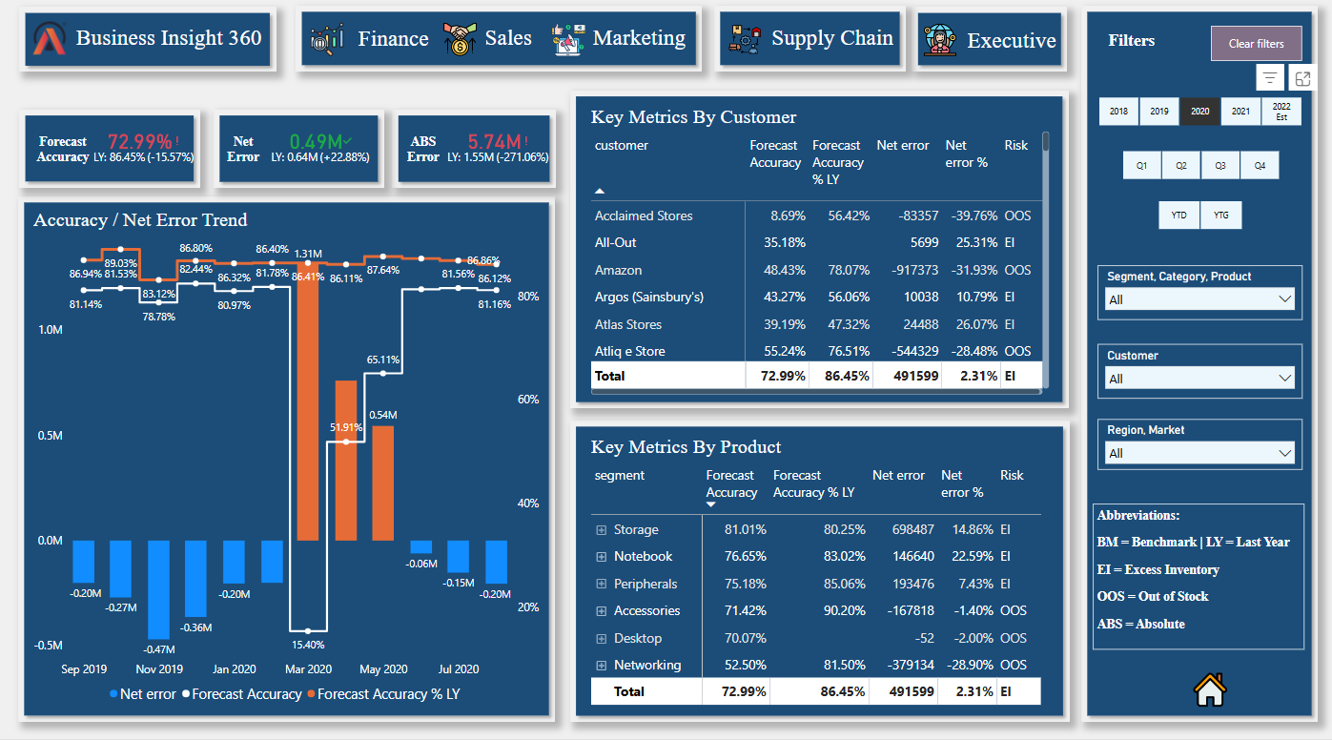
Supply Chain View:
The Supply Chain view provides key performance indicators (KPIs) and metrics related to supply chain management, such as:
Forecast Accuracy: Measurement of how accurately the company predicts demand.
Net Error and Absolute Error: Calculation of forecast errors.
Risks: Analysis of supply chain metrics for different customers and products.
Accuracy and Net Error Trend: Comparison of forecast accuracy with the previous year, along with net error.

Slide 13
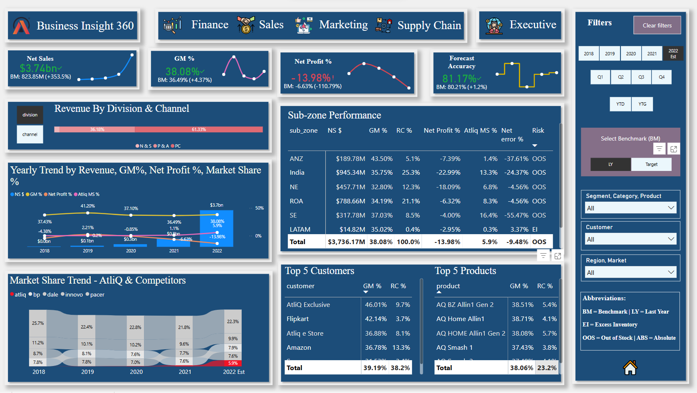
Executive View:
The Executive view offers a high-level summary of key performance indicators (KPIs) across all departments, including:
Trends: Visual representation of trends over time for quick insights.
Comparative Analysis: Comparison of current performance against targets and previous periods.
Actionable Insights: Recommendations based on data analysis to drive strategic decisions.
Key Metrics: Net sales, gross margin, net profit, and other critical financial metrics.

Slide 14





Implementing the Solution: Challenges and Lessons Learned
The implementation of the data-driven approach presented various challenges, but also provided valuable lessons for future initiatives.
User Adoption
Data Quality
Encouraging user adoption of the dashboards was crucial for maximizing their impact.
Maintaining high data quality was essential for the accuracy of insights generated from the dashboards.
Communication and Collaboration
Change Management
The transition to a data-driven culture required careful change management to address resistance.
Effective communication and collaboration among stakeholders were critical for success.

Slide 15

The Road Ahead: Sustaining Data-Driven Decision-Making
AtliQ's journey to data-driven decision-making continues. The company is committed to continually refining its approach to ensure long-term success.
Data Governance
Data Literacy
Implementing robust data governance policies to ensure data quality and security.
Investing in data literacy initiatives to empower employees to leverage data effectively.
Continuous Improvement
Embracing a culture of continuous improvement, iteratively refining data-driven processes.

